Slide 1
流程圖與執行結果
410485048 資工二 吳承儒

Slide 2
流程圖

Slide 3
SERVER

Slide 4
TcpListener()
Tcp.start()
Udp.Bind()
While(true)
New backgroundWorker
While(true)
Run udpRecv
Asynchronous
Run backgroundWorker
Tcp.accept()
udpRecv()
CATCH
TRY
isConnected
Disconnect
TcpRecv
udpBroadCast
Tcp.accept()
udpBroadCast
GetPhoto
CallBack
Get Client information
New networkStream
Pulling photo byte[]

Slide 5
CLIENT

Slide 6
MainForm()
Init_messenger
加入聊天
Tcp.connect
setSocketOption
Transfer to Image
Parse if there is emoji
Udp.bind()
Recv photo bytes[]
Recv textmessage
New networkStream
While(true)
While(true)
Send information
Run backgroundworker(TCP recv)
New backgroundworker
Run udpRecv()
Set udpRecv() STAthread

Slide 7
Other Function
If Click送圖片
If isEnter(Keyboard)
If Click 圖片
Image to byte[]
String to byte[]
Image to byte[]
Networkstream sending byte[]
Udp send text
FileStream to bmp and SaveFile

Slide 8
執行結果

Slide 9
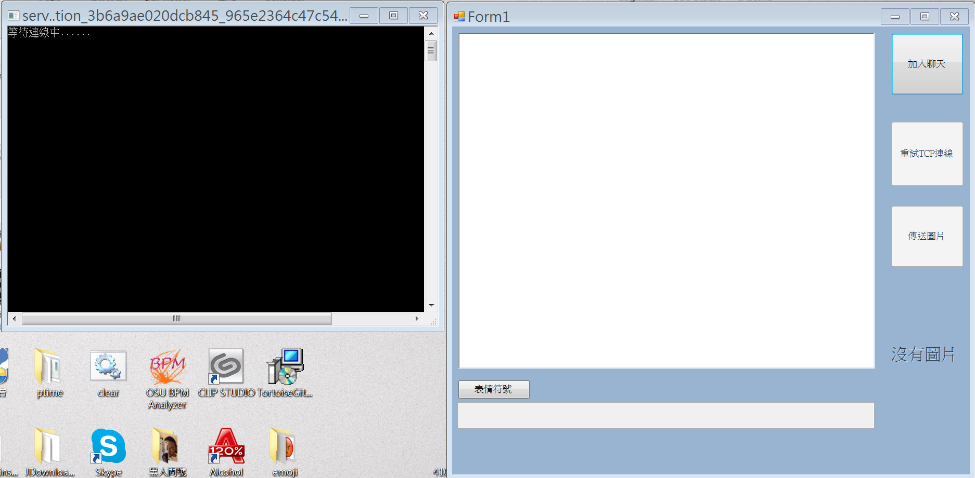

Slide 10
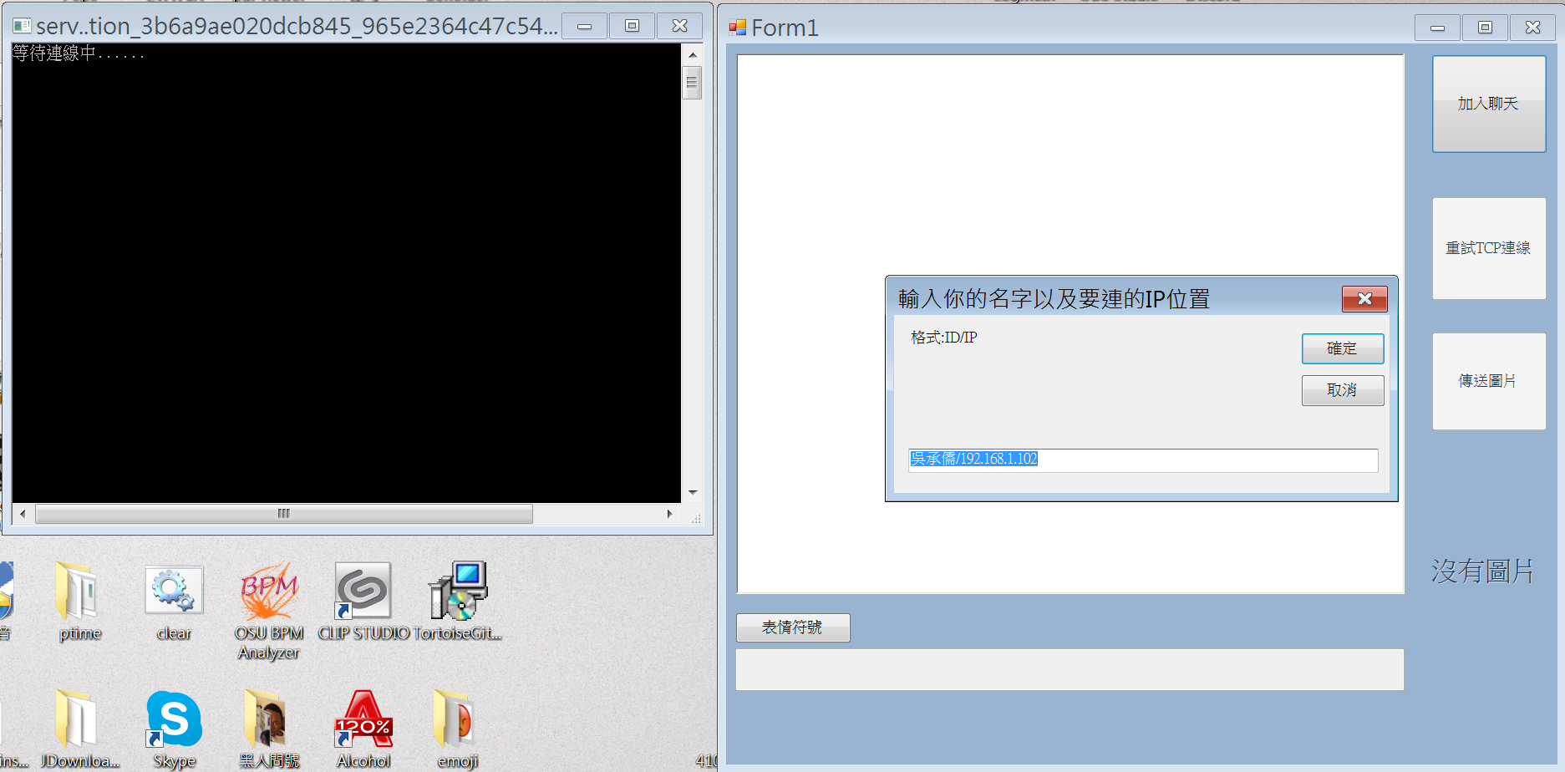

Slide 11
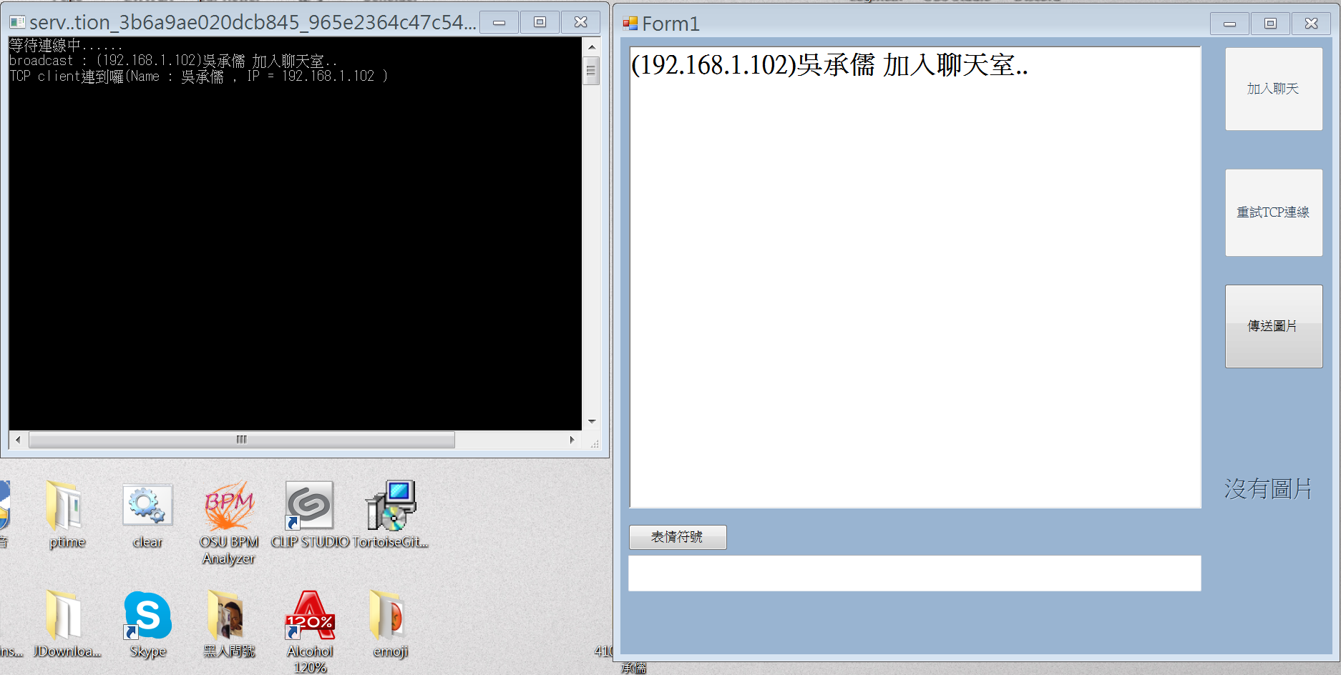

Slide 12
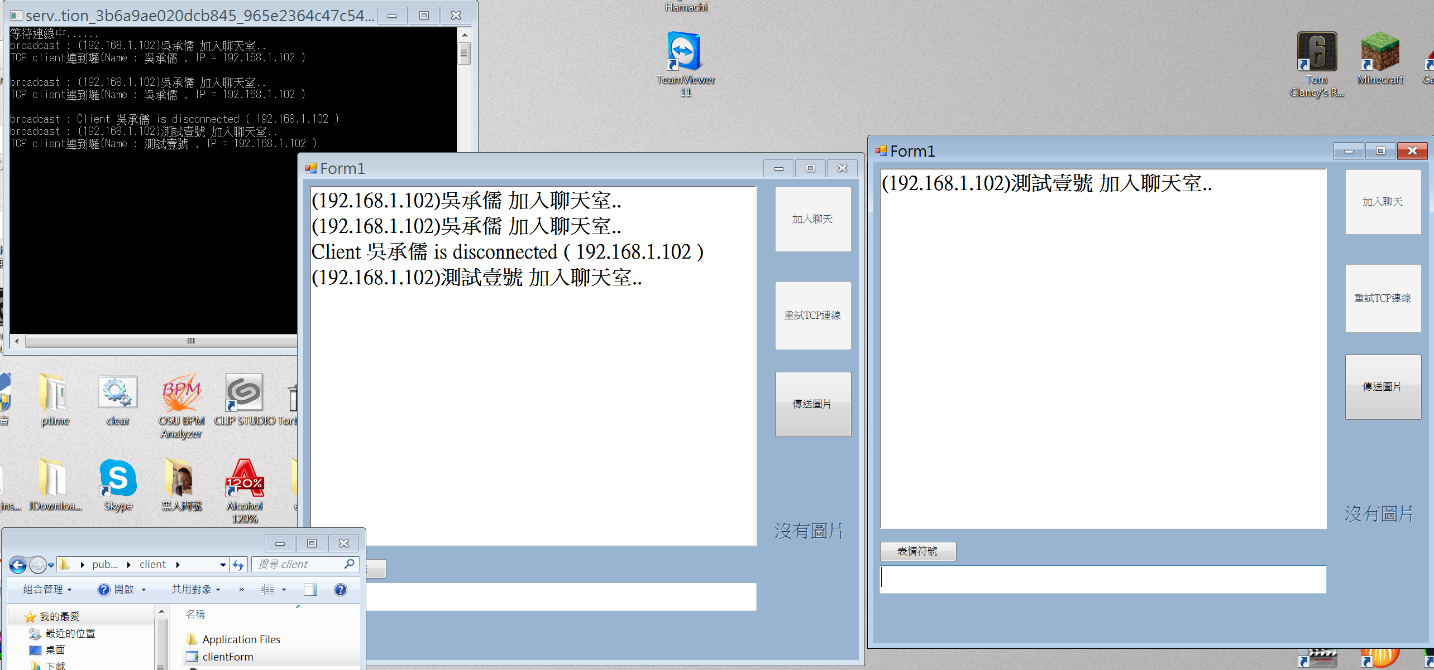

Slide 13
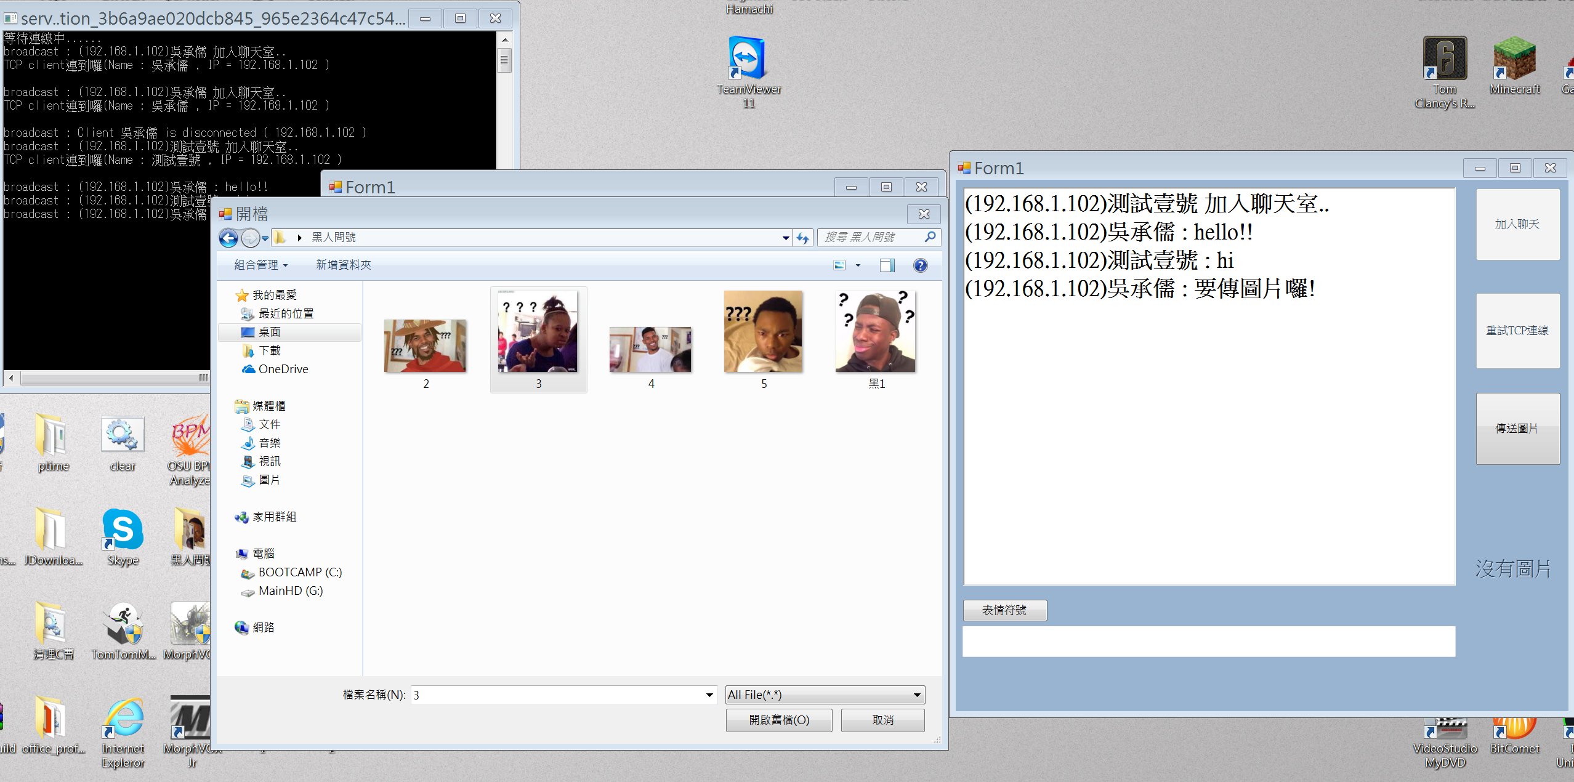

Slide 14
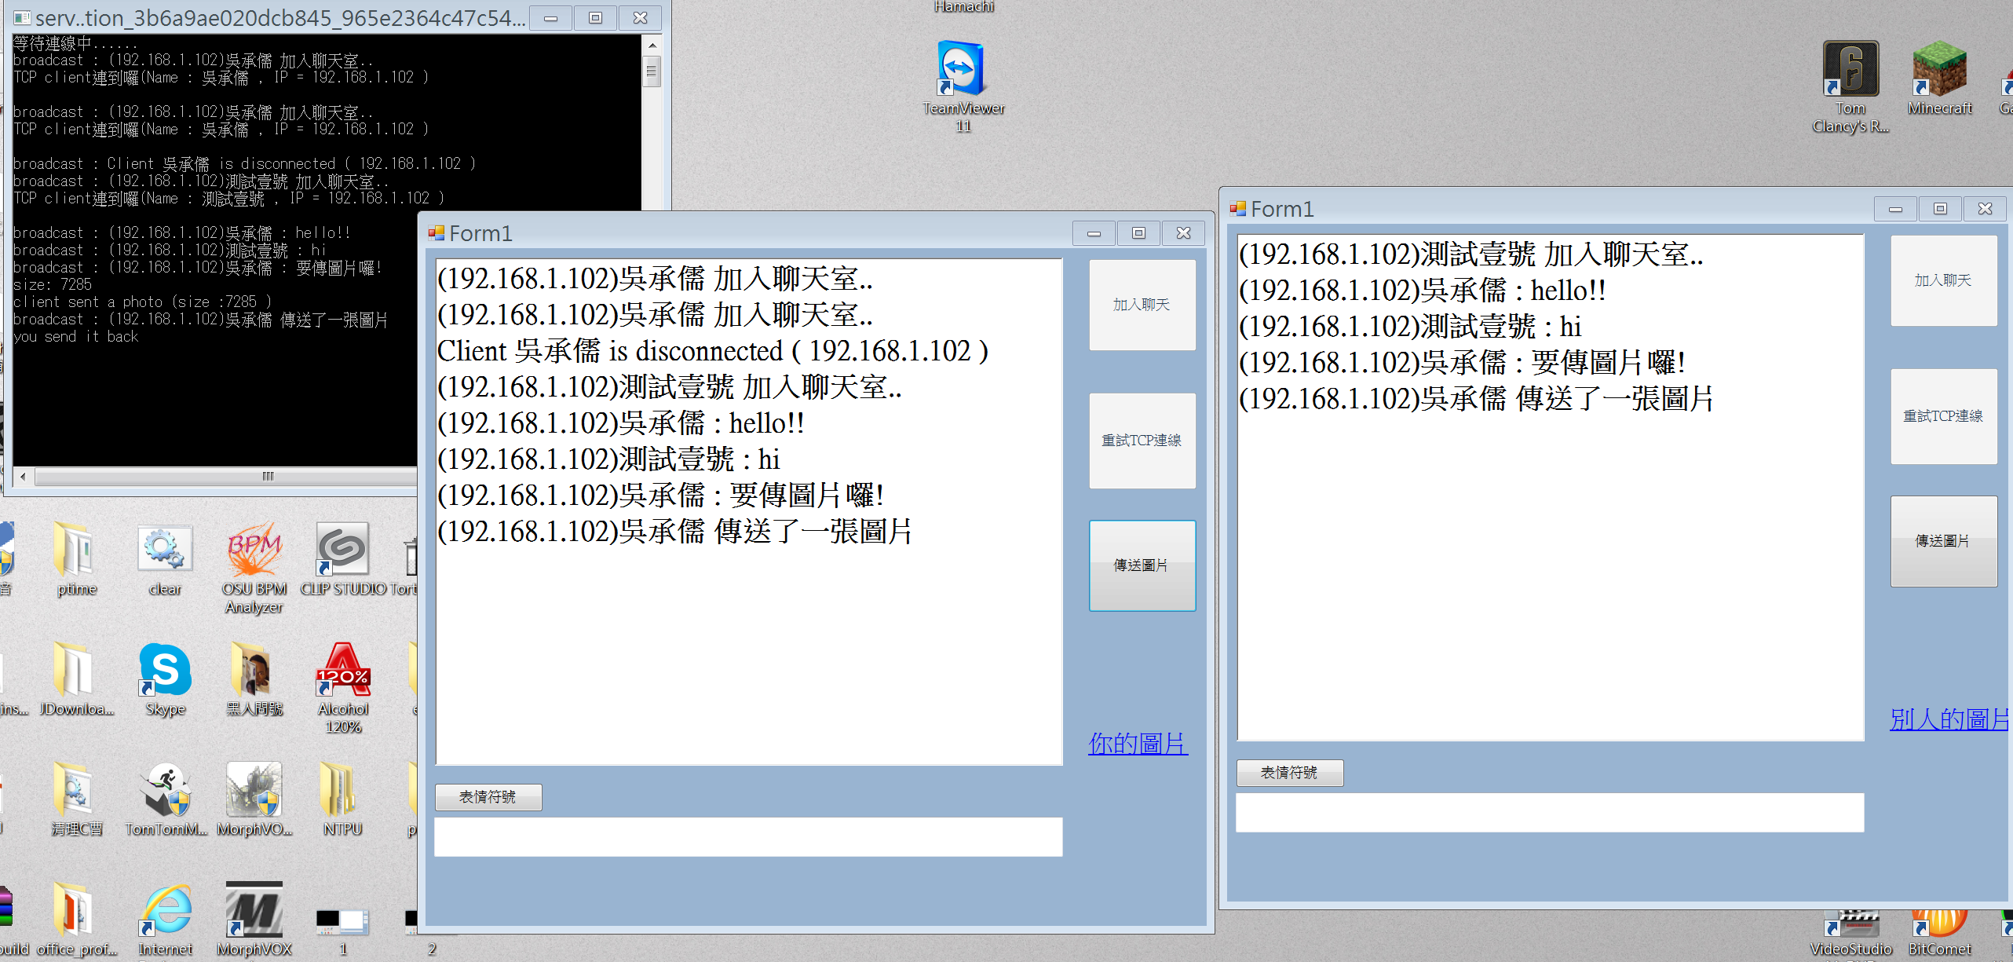

Slide 15
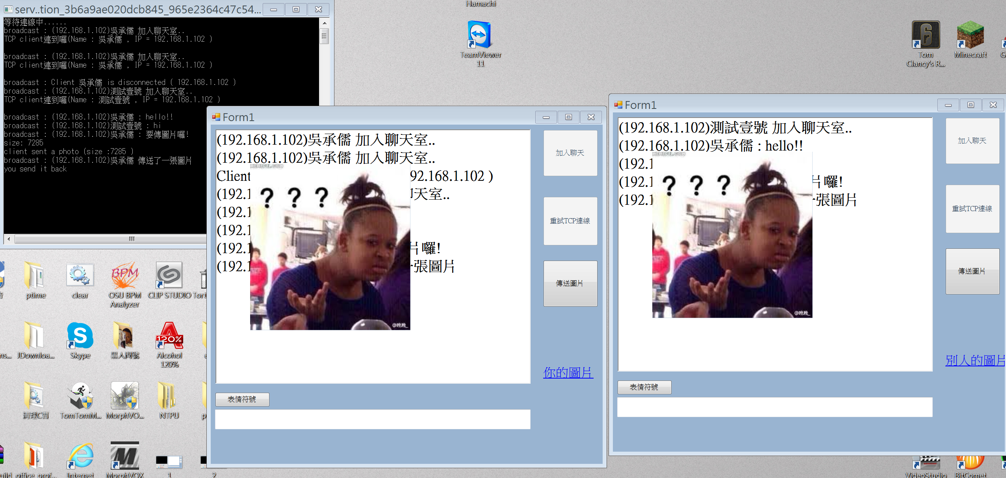

Slide 16
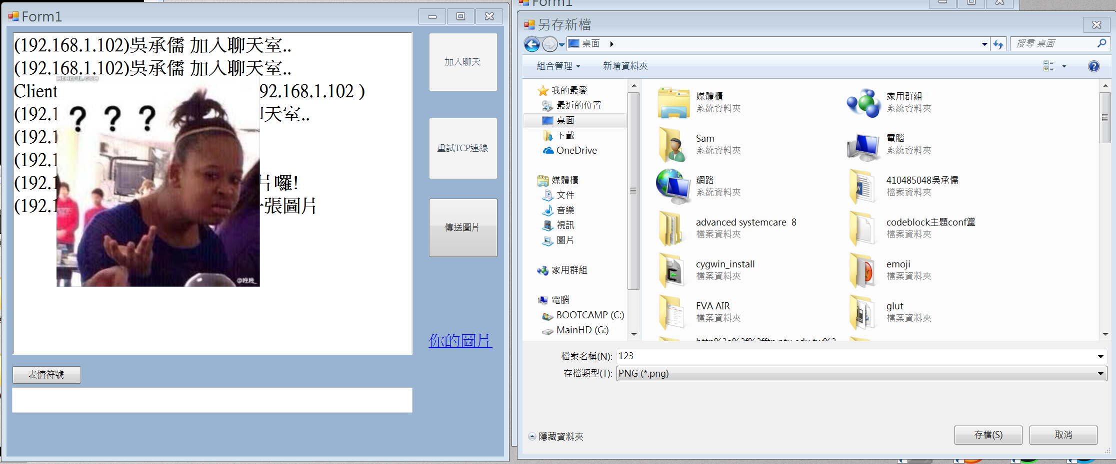

Slide 17
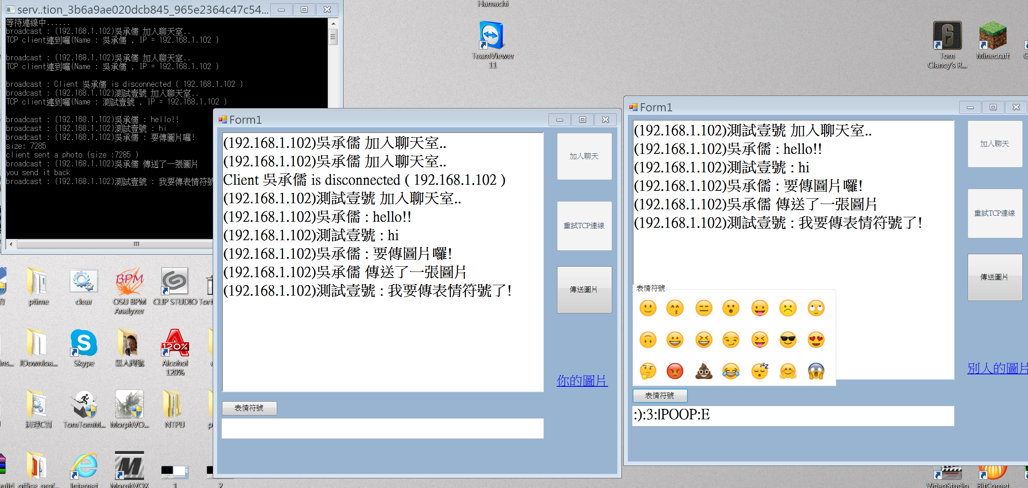

Slide 18
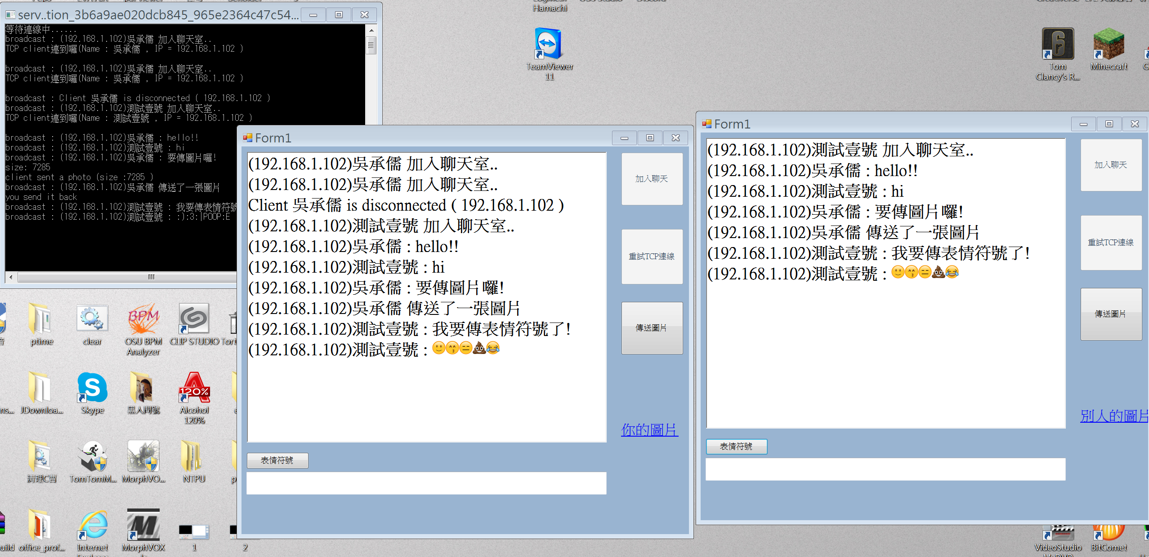

Slide 19
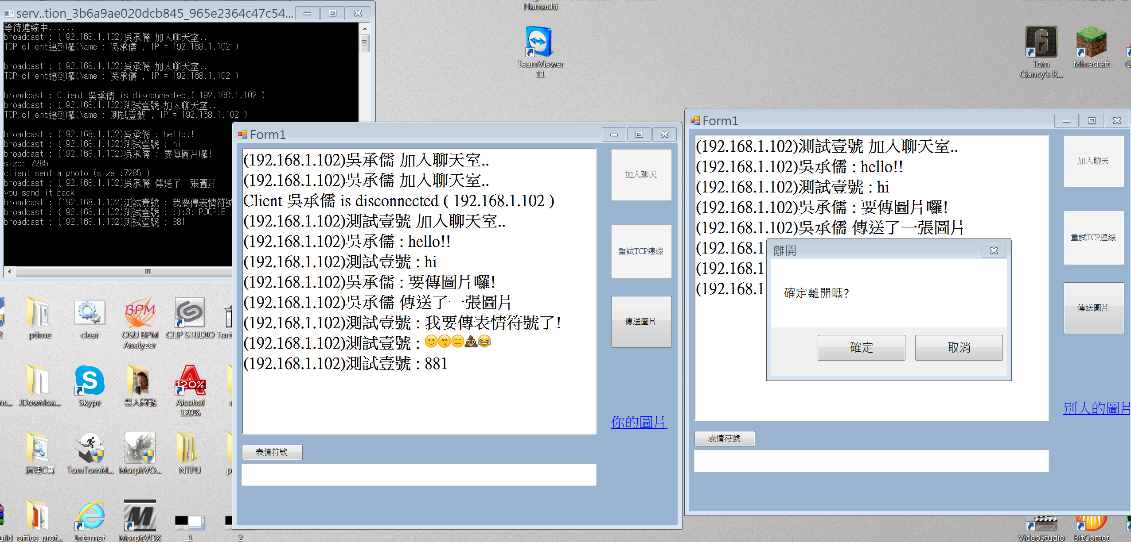

Slide 20
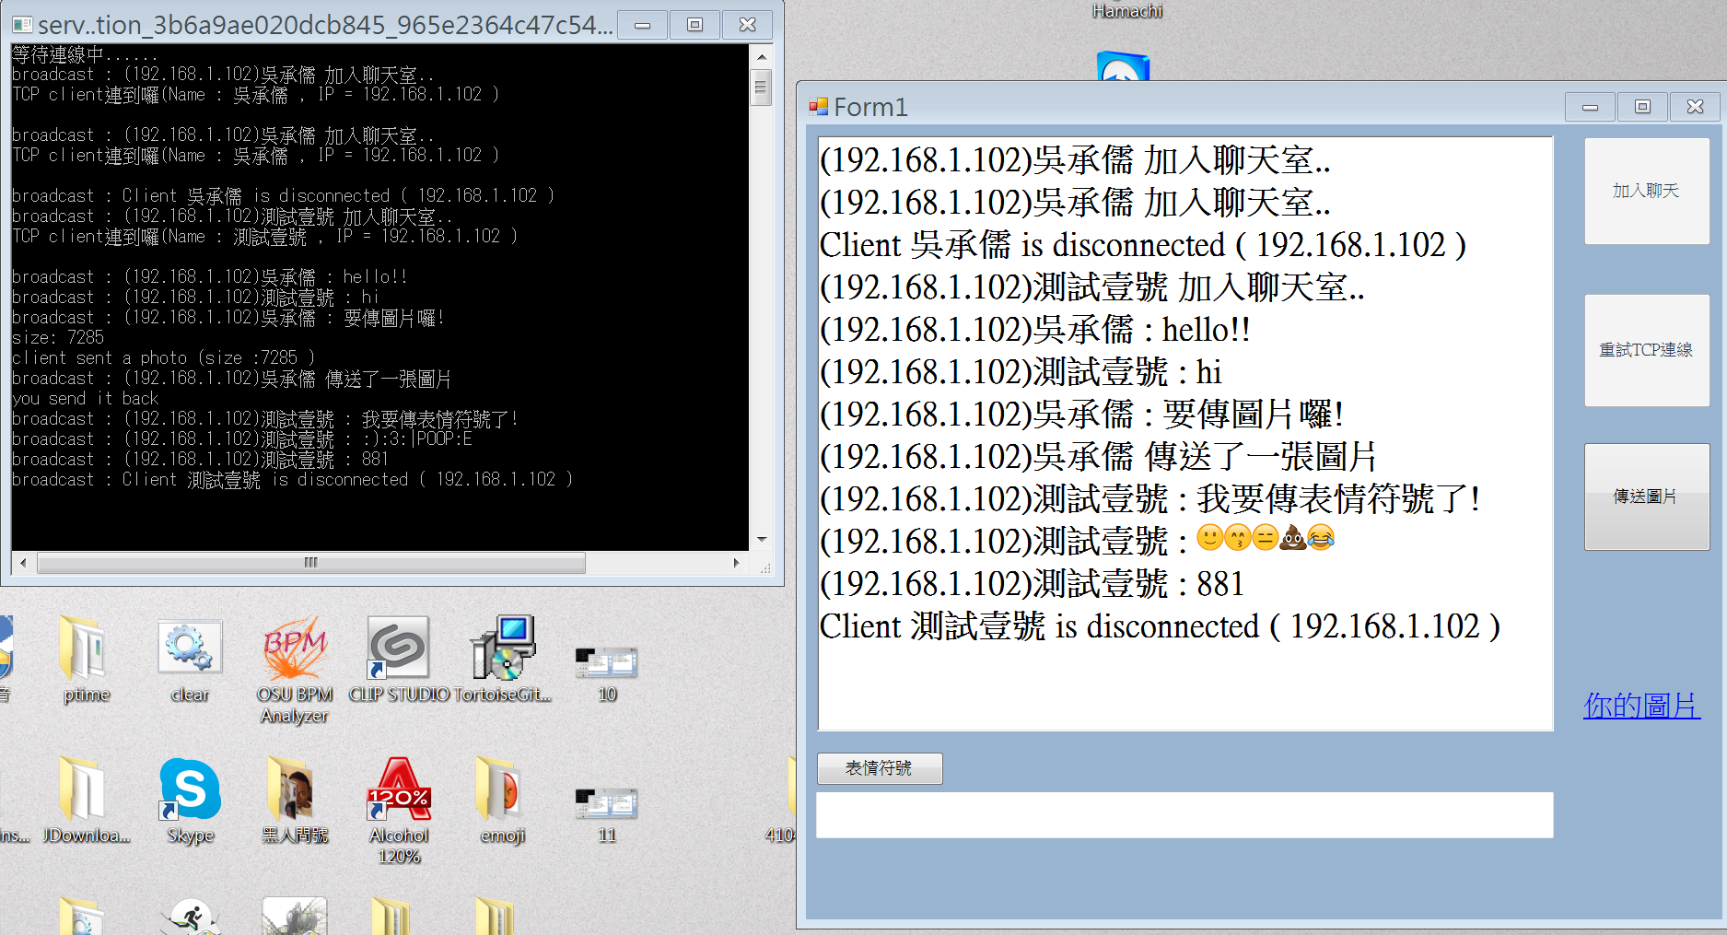

Slide 21
